Slide 1
MODULE 3: SUSTAINABLE LAND USE; ZONING; TRANSPORT AND MOBILITY
Alexandra Velasco, Luisa Aldrete, Roberto Uebel, Leasa Daniel, Ruthlyn Phipps, Xia-Xiang Claxton

Slide 2
General facts

Slide 3
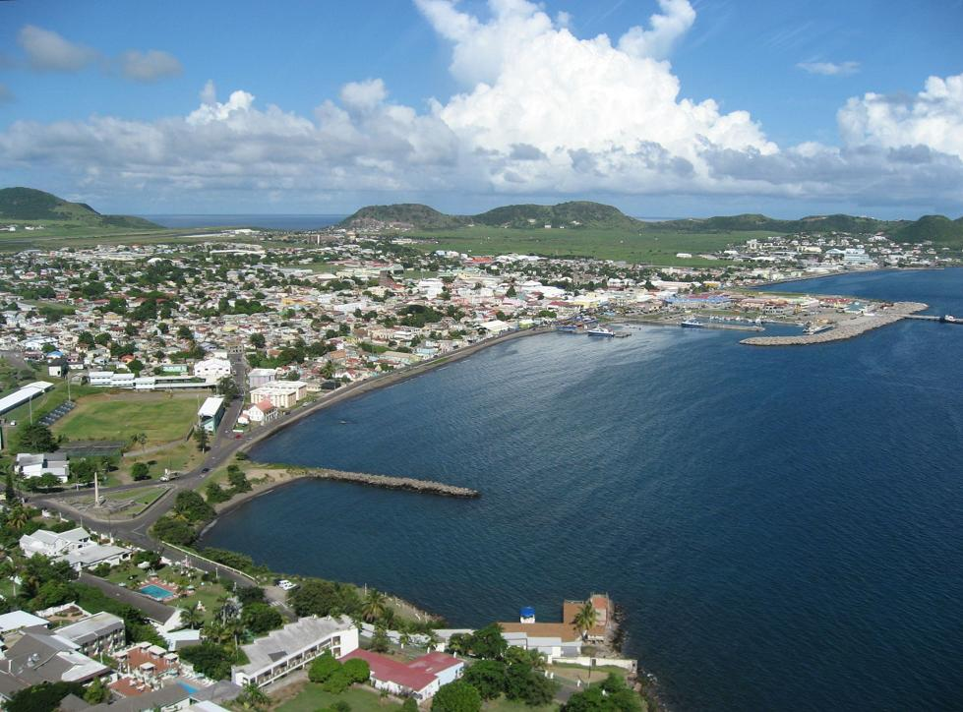
Basseterre, Saint Kitts and Nevis
Area: 6.1 km2
Population: 19.000 inhabitants (2013)
Density: 2,54/km2
Weather: 29 °C, E Wind 24 km/h, 72 % humidity
HDI: 0,752

Slide 4
What is sustainable land use and zoning?
"In its most pragmatic sense, the right to the city is born out of the collection of basic rights to well-being and development, such as the right to decent housing and the efficient provision of basic services that are friendly to the environment, the right to an adequate quality of life, the right to social, individual and psychological well-being, as well as from the creation and revitalization of the public space in order to foster citizen participation and co-responsibility, being the material support of social, cultural, learning and recreation”. UNDP, 2015

Slide 5
What is sustainable land use and zoning?
Integration of the informal city with the formal city by matching the level of services between rich and poor neighborhoods, which implies public or private investment in infrastructure, equipment and services
Provision of social services with a priority focus on vulnerable groups, adjusting to the realities and needs of the communities
Integral interventions, combining physical interventions with social and in some cases economic, and integrated and coordinated execution of the different components
Participation of the community in all stages of the intervention and maintenance.

Slide 6
SUSTAINABLE LAND USE AND ZONING
ISSUES | SOLUTIONS AND RECOMMENDATIONS
Residential zones outside Basseterre don‘t have any other services like food stores, leisure places, service centers | Reserve land space for green areas, wide pedestrians zones, and plan urban centralities > descentralization of services
No wide enough side-walks in the streets, no inner parks, no green furniture in public spaces | Take out one lane used for parking areas, and make wider pedestrians zones, with trees and urban furniture and pacified transit. Public transport system for avoiding use of private car in city center Rulement for public spaces
Urban heat islands due to artificial barriers like high buildings in the shore. | To create inner green areas, green roofs and other green surfaces in order to refresh the area To plan a comprehensive building code that plans efficients heights for buildings taking into account the wind currents, sun movements, rain and humidity > urban metabolism

Slide 7
SUSTAINABLE LAND USE AND ZONING
ISSUES | SOLUTIONS AND RECOMMENDATIONS
Big areas of land and with the best location and view are bought by rich foreigners causing higher land prices (land speculation) > expulsion of local inhabitants | Comprehensive land use plan that taxes more foreigner investors and compensates local people for their land
No land reserve for stopping urban sprawl or land prize speculation | Government has to have land control through a land reserve in the surroundings of Basseterre in order to avoid urban sprawl
Products that can be produced in Basseterre, are imported from other distant countries, like milk, meat, poultry, some fruits and manufactured food. | Government have to designate land for food production either in the outskirts of Basseterre or inside as urban agriculture program
Vendors on the side walks occupy space for pedestrians | Rules for vendors and relocalitzation in appropiate sites

Slide 8
What is sustainable transport and mobility?
The term transportation refers to all movements in a transport network, while mobility describes the possibility and ability of an individual to move.
Therefore, mobility is the possibility of an individual to participate in activities that require travel. Each citizen should have the option to be part of social, economic, cultural and political activities, therefore, the main criterion of quality of mobility is not the distance covered, but the number of activities that an individual performs.
Sustainable mobility refers to the possibility for an individual to carry out his activities without compromising the availability of natural and energy resources for present and future generations and where, on the whole, individual actions are aimed at improving the quality of the environment, maintaining a balance between economic, social and environmental protection.

Slide 9
SUSTAINABLE TRANSPORT AND MOBILITY
ISSUES | SOLUTIONS AND RECOMMENDATIONS
Too many cars inside the city center causing traffic, unsafety and big areas used for parking | Accesible and connective public transport system Parking in the borders outside the city Intermodality Pedestrianized zones inside the city center like the clock area Taxes for parking in public areas City center urban Tolls
Few pedestrians and cyclists in the streets | Safe intersections for pedestrians with zebra zones and traffic lights for them Wider sidewalks with trees and benches, bike lanes connecting origins and destinations Bikesharing system

Slide 10
Sustainable Transport and Mobility -Issues
ISSUES | SOLUTIONS AND RECOMMENDATIONS
Intersections don‘t work efficiently | Comprehensive program of intelligent traffic lights in the intersections
No policies for transport | Sustainable masterplan for transport and mobility
Railways system is used only for tourism and is not well maintained | Public investment for railways system for commuting and not only for tourism, creating intermediate train stations for people and modern wagons

